Slide 1
Welcome to Rainbow Nursery
Please come in and explore the room and the toys and play with your little one.
At about 2.40pm we will have a parents talk where we will share information with you about what we do, what you need to bring and more.

Slide 2

What will your child be learning with us?
And to develop a growth mindset…… - Independence/ ‘I cant do it yet’

Slide 3
We have 3 rules throughout our School:
Be ready (for learning – looking, listening, developing focussing skills)
Be safe (are we keeping ourselves and others safe? ie walking inside, running outside, kind hands etc)
Be kind (am I being a good friend? Learning to help and care for others and living things).
We teach our children that everyone is different in many ways and that is what makes everyone special.

Slide 4
Working with you
Messages via the school ‘Spider app’
Nursery class page on our school website.
Termly parents meetings
Sharing observations/ photographs of your child’s learning online.
‘Stay and Play’ sessions in class

Slide 5
Our Daily Routine
Morning session – 9.00am – 12.00pm
Afternoon session - 12.00 pm – 3.00pm
Full day - 9.00 am- 3.00pm
Please be on time for drop off/ pick ups.
For each session there is a clear routine so children know what is coming next.

Slide 6
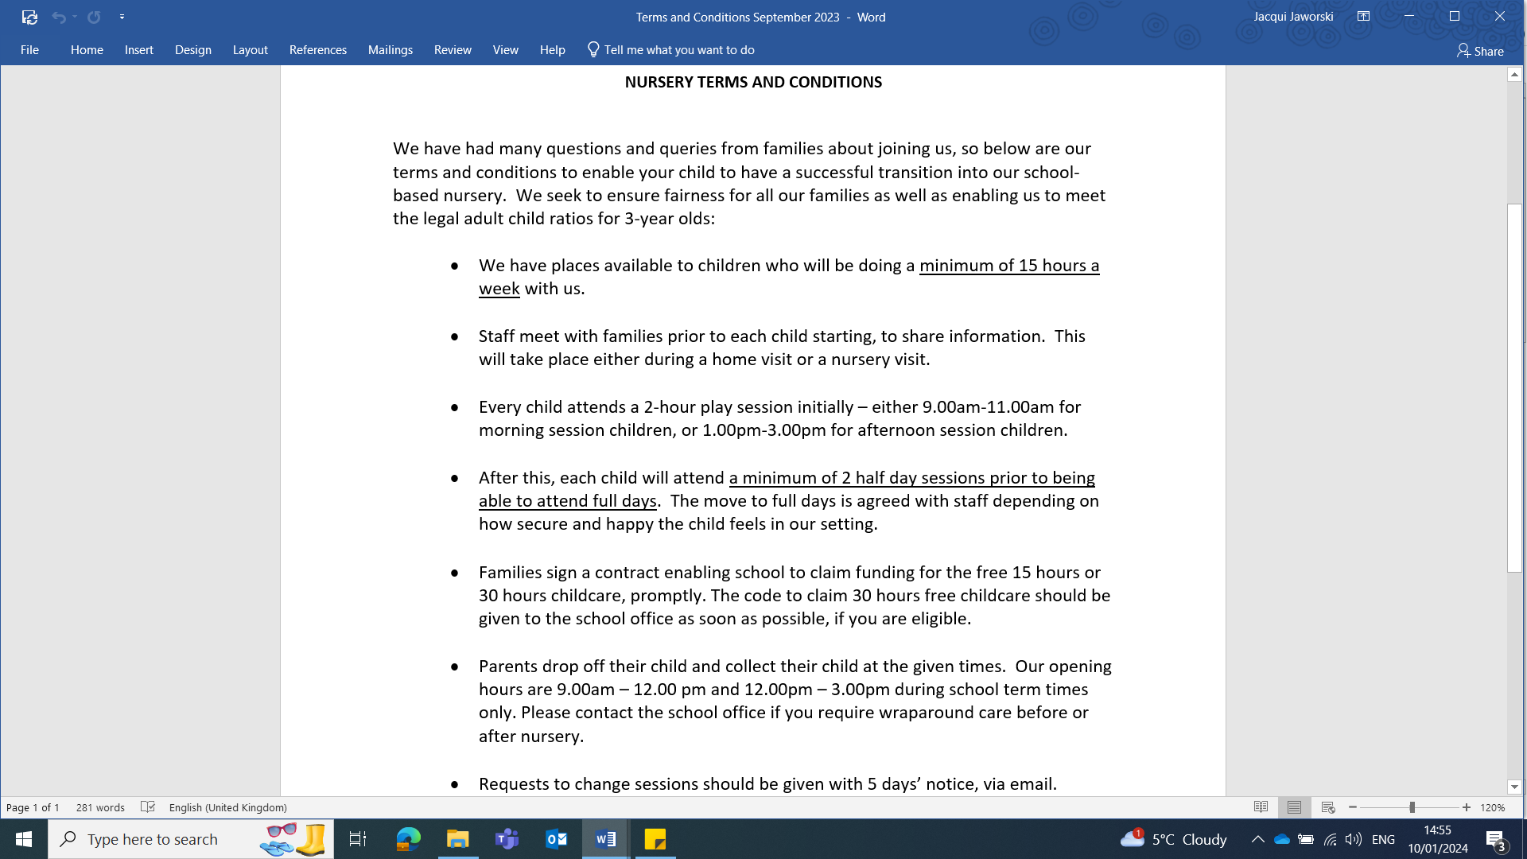

Slide 7
Settling In
Every child must :
Come for a 2 hour play session.
Then come for full half day sessions if they feel happy enough.
If you want your child to do full days we must both agree your child is ready.
All children are different and unique and some children may find it trickier to settle when they start.

Slide 8
Full days in Nursery
If you are thinking about your child doing a couple of full days in Nursery-
We will need your eligibility code before your child can access their 30 hours free child care.
Paid sessions cost £15 – ie half day costs £15, and a full day costs £30.
Parents provide a packed lunch for their child

Slide 9

Snacks/lunch
All children will be offered a healthy snack of milk or water and a piece of fruit during a play session.
Children need a labelled water bottle so they can drink whenever they wish. Sorry no squash or juice allowed.
Please do not pack snack/treats in your child’s bag as we have children with food allergies.

Slide 10
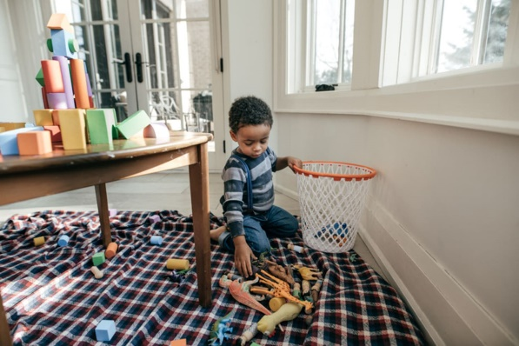
How to help your child to have a great start in Nursery:
Regular attendance on the days/sessions you have been allocated – dev friendships and learn and develop the skills needed for big school.
Daily bedtime story to develop speech.
Teach your child to look at you and listen to you when you give them information – this helps them to learn faster and make accelerated progress.
Expect them to tidy up their own toys and to
help you.

Slide 11
Toileting
We want your child to become as independent as possible in preparation for school.
It is important that they can manage going to the toilet by themselves.
Please support your child to practice using the toilet and wiping themselves at home.
Practice flushing the toilet when they have been and washing and drying their hands.
This will help your child to feel more confident when using the toilet in Nursery.

Slide 12
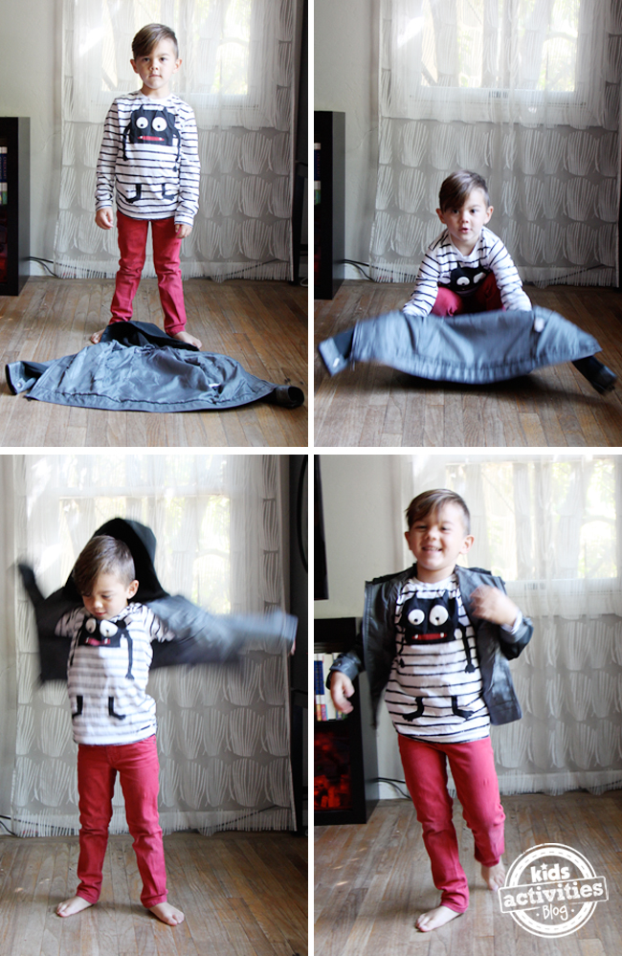
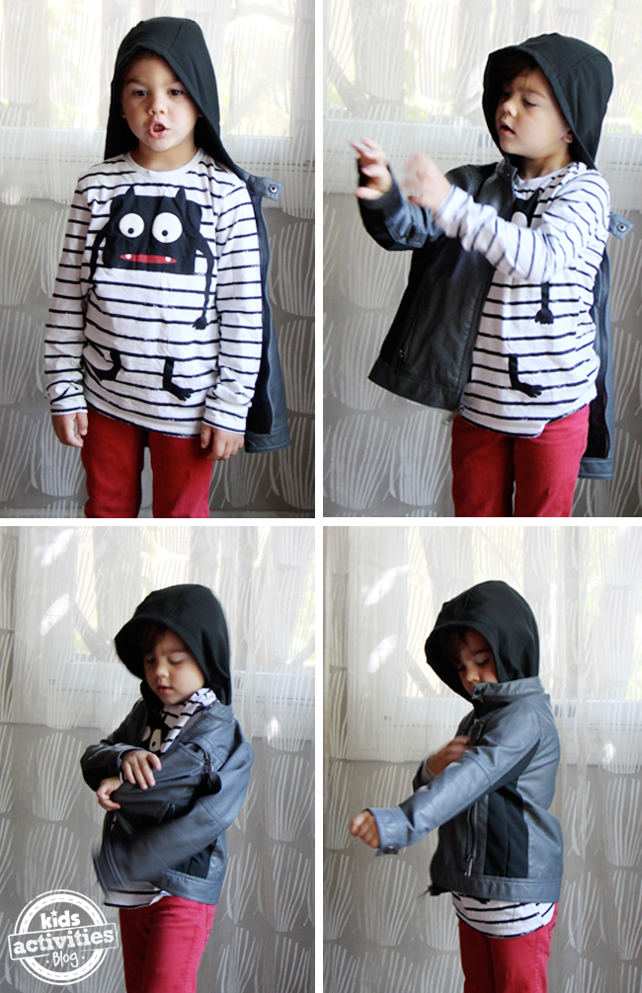
Teach your child to put on their own coat on and take it off independently.

Slide 13
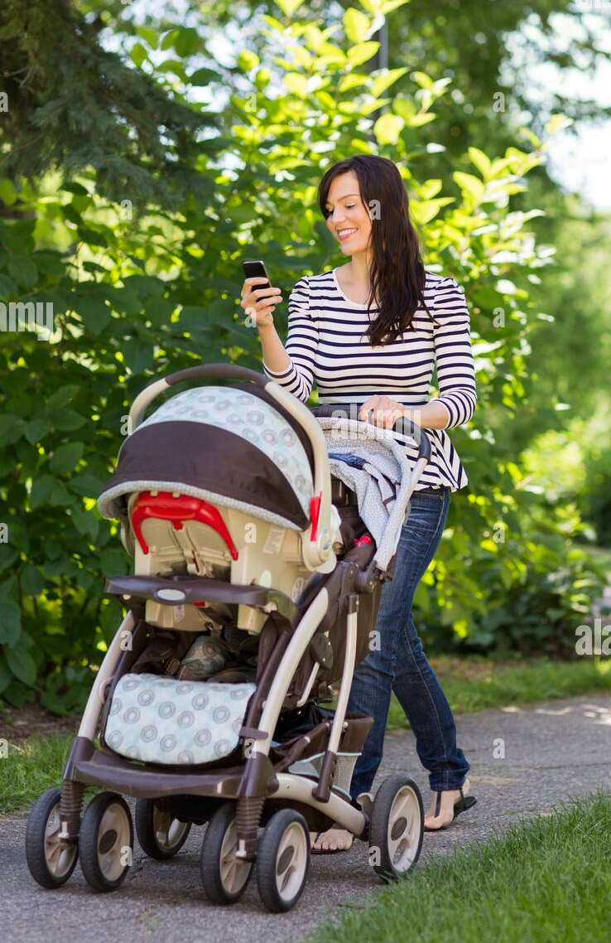
Talking to your child about anything and everything is the best thing you can do to support their development.
Every child only has today once and time is precious. Let’s make the most of every child before they grow up.

Slide 14
Keeping Your Child Safe
Up to date contact numbers please in case we need to contact you in an emergency.
Up to date medical information about your child including allergies like asthma, hay fever and eczema.
If your child needs medicine while they are in Nursery please hand in to the school office and complete a consent form.
You must also let us know if someone different is coming to collect your child – we will not release them to someone we don’t know.

Slide 15
We are a school based Nursery and operate during school hours only
Please be on time for all drop offs/ collections. If you have siblings please collect your nursery child first as we close first.
All gates around school are locked promptly.
Remember if school is closed – we are closed.

Slide 16

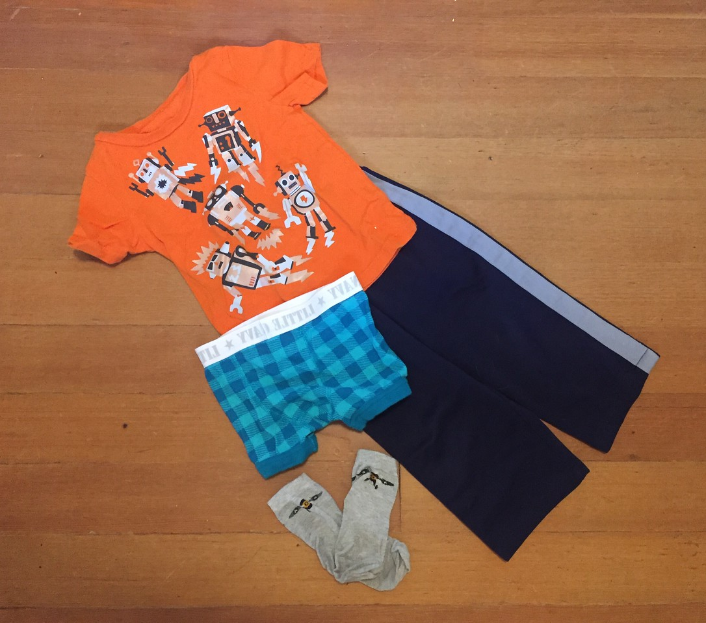


What your child will need
Clothing that they can manage themselves when they go to the toilet.
No ‘best clothes’ - they will get messy as they paint and play in the mud kitchen.
A spare set of clothes (especially undies and trousers/skirts) in a labelled bag in case of accidents.
A warm waterproof coat with a hood – we go out in ALL weathers.
Shoes with velcro fastenings for independence if possible .
A family photograph for our family display.
PLEASE LABEL EVERYTHING

Slide 17
What happens now?
Make sure you have signed up for a home visit.
2 hour settling in session – Thursday 12th September (am or pm)
2X Half day visits Friday 13th/Monday 16th (am or pm)
If your child has settled they can increase their hours from Tuesday 17th September
We look forward to you and your little one to joining us.

